Slide 1
Dependency Parsing
Natural Language Processing
(based on revision of Chris Manning Lectures)

Slide 2
Announcement
TA announcements (if any)...

Slide 3
Suggested Readings
https://web.stanford.edu/~jurafsky/slp3/14.pdf (dependency parsing)
Incrementality in Deterministic Dependency Parsing
A Fast and Accurate Dependency Parser using Neural Networks
Dependency Parsing
Globally Normalized Transition-Based Neural Networks
Universal Stanford Dependencies: A cross-linguistic typology
Universal Dependencies website

Slide 4
Two views of linguistic structure: Context-free grammar and
Dependency grammar

Slide 5
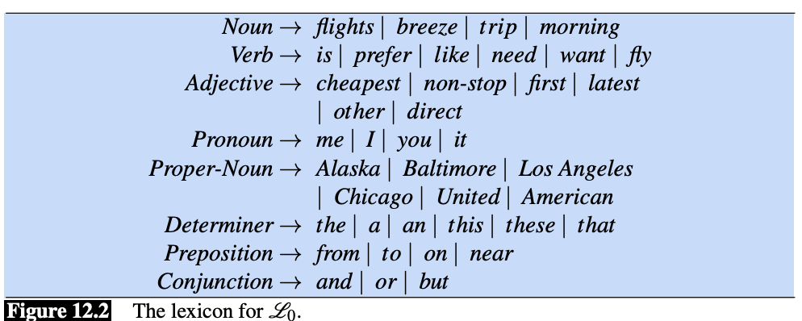
Two views of linguistic structure: Context-free grammar
Phrase structure organizes words into nested constituents
Starting unit: words
the, cat, cuddly, by, door
Words combine into phrases
The cuddly cat, by the door
Phrases can combine into bigger phrases
The cuddly cat by the door
det
noun
adj
prep
noun
np: noun phrase
prep
np
pp: prepositional phrase
We called the word on the right (e.g., the) terminal symbols, and the grammar rules as lexicon
np
np
pp
np

Slide 6
Two views of linguistic structure: Context-free grammar
NP -> Det N
e.g., the cat
VP -> V PP
e.g., talk to the cat
NP -> Det (Adj) N
e.g., the large cat
S -> NP VP
e.g., the cat walked behind the dog
PP -> P NP
e.g., by the door
More grammar rules! As much as we want….
NP -> Det (Adj) N (PP)
e.g., the large cat by the door
NP -> Det (Adj)* N (PP)
e.g., the large cute furry cat by the door

Slide 7
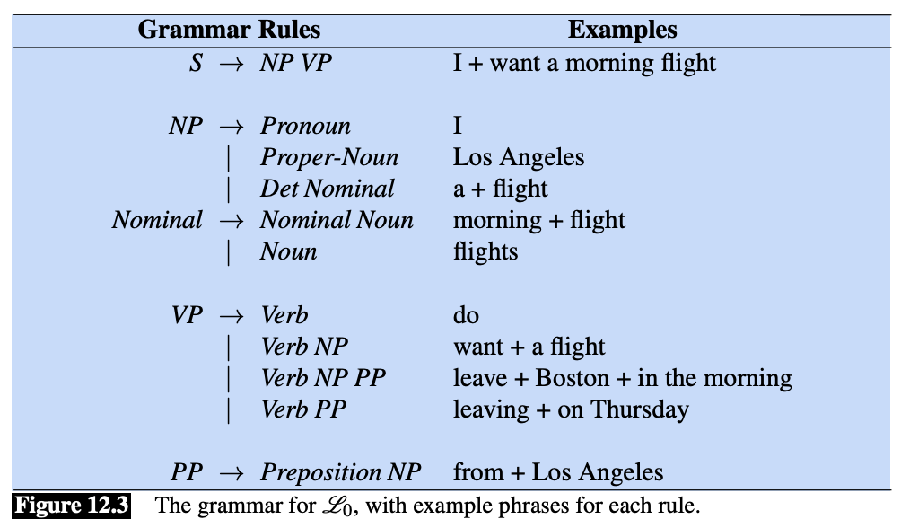
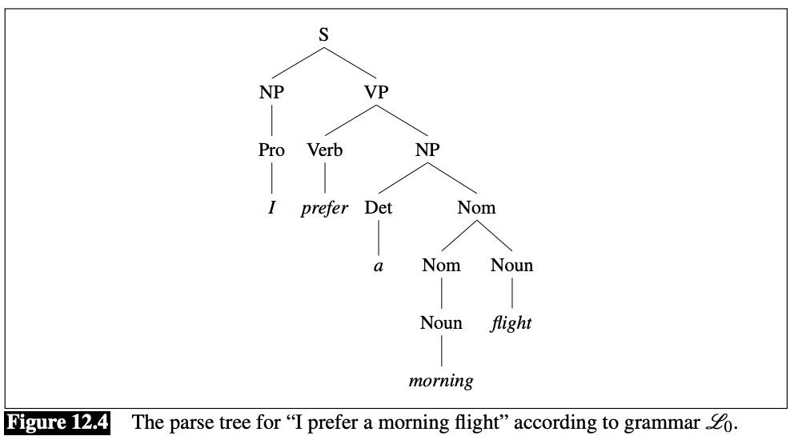
Two views of linguistic structure: Context-free grammar
Using context-free grammar to parse gives us a parse tree
CFG is useful for grammar checking (check whether the sentence deviates from the lexicon), entities extraction (check common pattern), sentence classification (e.g., question has certain pattern)

Slide 8
2. Two views of linguistic structure: Dependency grammar
Dependency structure shows which words depend on which other words
Look in the large crate in the kitchen by the door
E.g., crate “depends on” the word “large”. Here “crate” (start of the arrow) is called “head” and “large” (where the arrow point to) is called the “dependent”

Slide 9
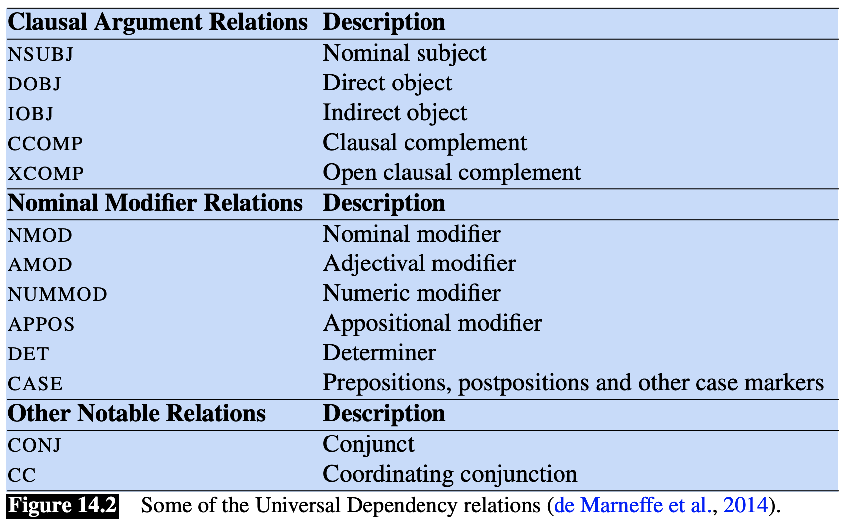
2. Two views of linguistic structure: Dependency grammar
https://universaldependencies.org/u/dep/

Slide 10

Prepositional phrase attachment ambiguity
obl:oblique
nmod: noun modifier
subj
subj
obj
obj

Slide 11
How to link?
obj
nmod
The board approved [its acquisition] [by Royal Trustco Ltd.]
[of Toronto] [for $27 a share] [at its monthly meeting]
verb
noun
pp
nmod
nmod
obl
pp
pp
pp
The number of possible parses grows exponentially w.r.t. to the number of prepositional phrases (here n = 4) (i.e., Catalan numbers)

Slide 12
Coordination scope ambiguity
coord
nmod
[Shuttle veteran] and [longtime NASA executive Fred Gregory] appointed to board
[Shuttle veteran and longtime NASA executive] Fred Gregory appointed to board
nmod

Slide 13

Adjectival/Adverbial Modifier ambiguity
obj
nmod
nmod
subj
nmod
nmod
nmod
nmod

Slide 14
Verb phrase (VP) attachment ambiguity
this?
or this?
Mutilated body washes up on Rio beach to be used for Olympics beach volleyball
VP

Slide 15
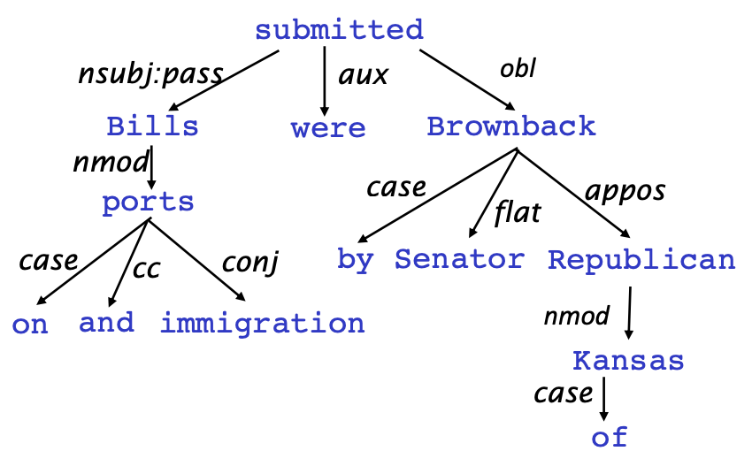
Dependency as tree
Dependencies can be redrawn as tree (motivated by computer science)
Dependencies usually form a connected, acyclic, single-root graph.

Slide 16
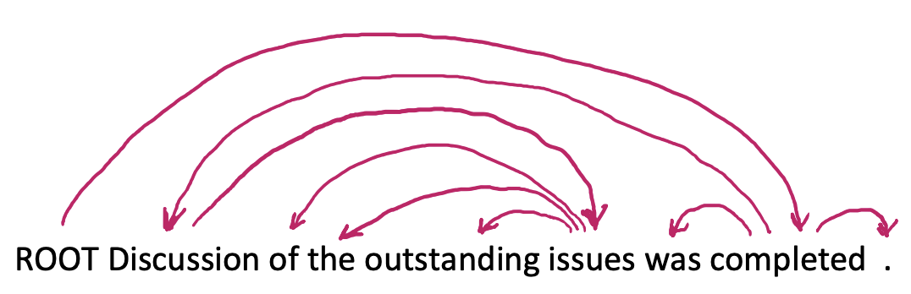
Dependency as tree
Some people draw the arrows one way; some the other way!
Tesniere (1959) had them point from head to dependent - we follow that convention
We usually add a fake ROOT so every word is a dependent of precisely 1 other node

Slide 17
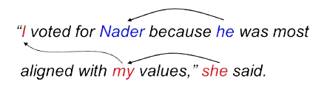
Why we need to learn sentence structure?
Humans need to work out what depends what
Thus, similarly, a model needs to understand sentence structure in order to interpret language correctly
E.g., coreference resolution
Human language is ambiguous by nature
Knowing these ambiguities allow us to watch out for these potential problems in our model

Slide 18
Dependencies Treebanks

Slide 19
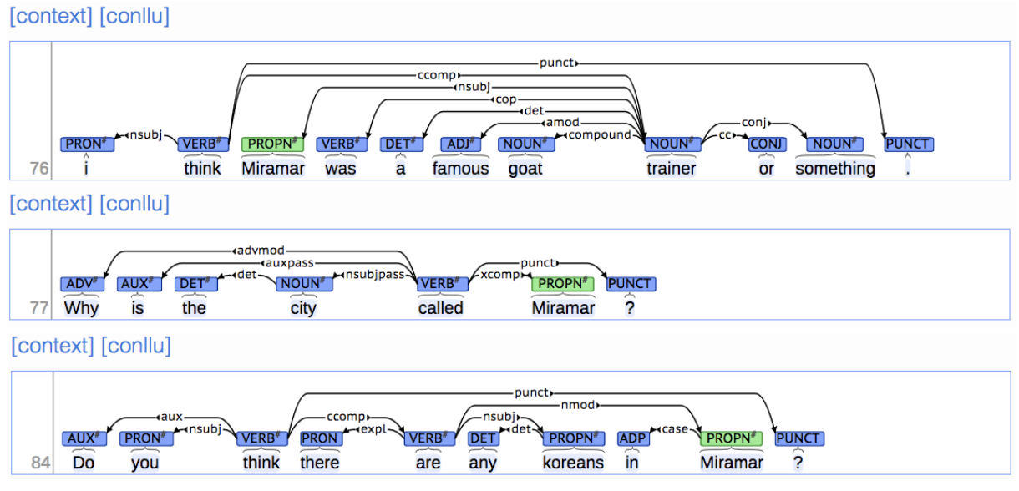
The rise of annotated data and Universal Dependencies treebank
Brown corpus (1967; PoS tagged 1979); Lancaster-IBM Treebank (starting late 1980s); Marcus et al. 1993, The Penn Treebank, Computational Linguistics; Universal Dependencies: http://universaldependencies.org/
Many parsers, part-of-speech taggers, etc. can be built on it
Broad coverage, not just a few intuitions
Contain frequencies and distributional information
Provide a way to evaluate existing NLP systems - turn NLP into actual science

Slide 20
So how do we build a parser once we got these dependencies?
Many information you can use from the treebanks
Bilexical affinities
Check whether both ends of dependencies seem right
Dependency distance
Check whether the distance is too far away from usual
Intervening material
Because sentences are normally organized around verbs, dependencies rarely span intervening verbs
Because punctuation (e.g., commas) indicates segment, it also indicates less plausible spanning intervening punctuations
Valency of heads
Given a head, what is usually its dependents and on which side?

Slide 21
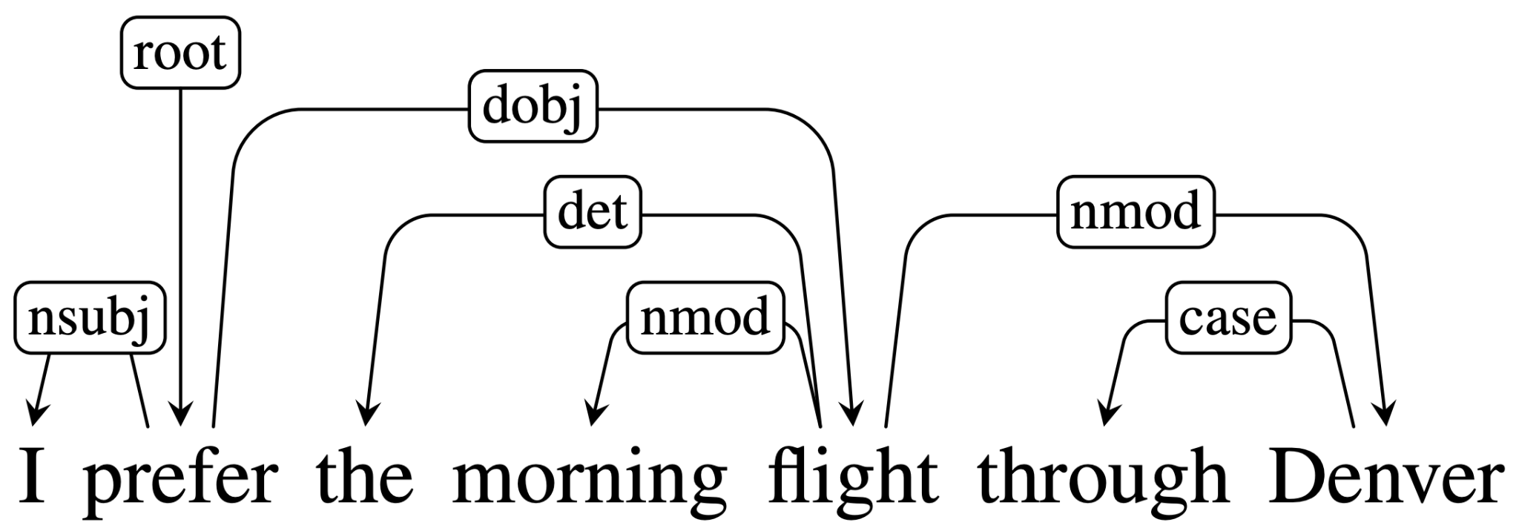
So how do we build a parser once we got these dependencies?
A sentence is parsed by choosing for each word, what other (including ROOT) it is a dependent of
To make the problem easier to solve, we impose some constraints:
There is a single designated root node that has no incoming arcs
With the exception of the root node, each vertex has exactly one incoming arc
There is a unique path from the root node to each vertex in V
Don’t want cycles, e.g., A->B, B->A

Slide 22
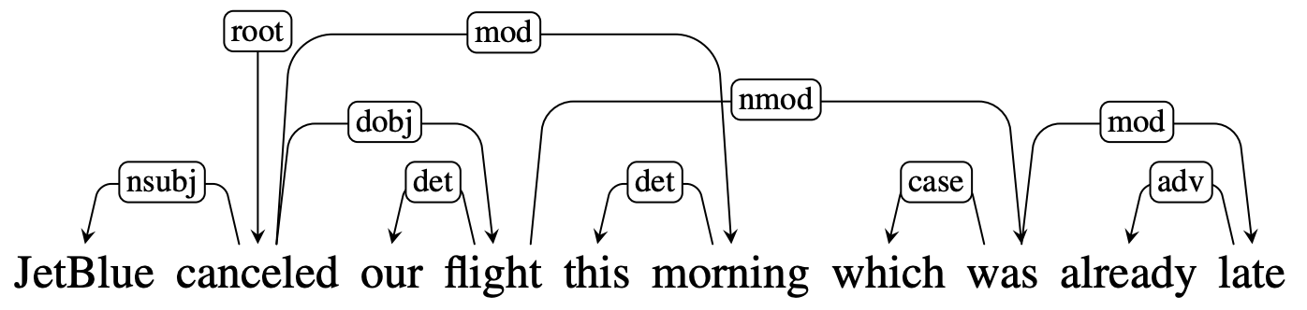
Projectivity
Note that some dependency parsing algorithms are projective:
Projectivity: An arc from a head to a dependent is said to be projective if there is a path from the head to every word that lies between the head and the dependent in the sentence. A dependency tree is then said to be projective if all the arcs that make it up are projective.
In this example, the arc from flight to its modifier was is non-projective since there is no path from flight to the intervening words this and morning. A dependency tree is projective if it can be drawn with no crossing edges. Here there is no way to link flight to its dependent was without crossing the arc that links morning to its head.

Slide 23
Projectivity
There are computational limitations to the most widely used families of parsing algorithms. The transition-based approaches we gonna discuss shortly can only produce projective trees, hence any sentences with non-projective structures will necessarily contain some errors. This limitation is one of the motivations for the more flexible graph-based parsing approach.

Slide 24
Dependency Parsing Methods

Slide 25
Greedy transition-based parsing [Nivre IWPT 2003]
A simple form of greedy discriminative dependency parser
The parser does a sequence of bottom up actions
Roughly like “shift” or “reduce” in a shift-reduce parser, but the “reduce” actions are specialized to create dependencies with head on left or right
The parser has:
a stack σ, written with top to the right
which starts with the ROOT symbol
a buffer β, written with top to the left
which starts with the input sentence
a set of dependency arcs A
which starts off empty
a set of actions
shift or left arc or right arc
An efficient algorithm for projective dependency parsing, Joakim Nivre, 2003. https://aclanthology.org/W03-3017/

Slide 26
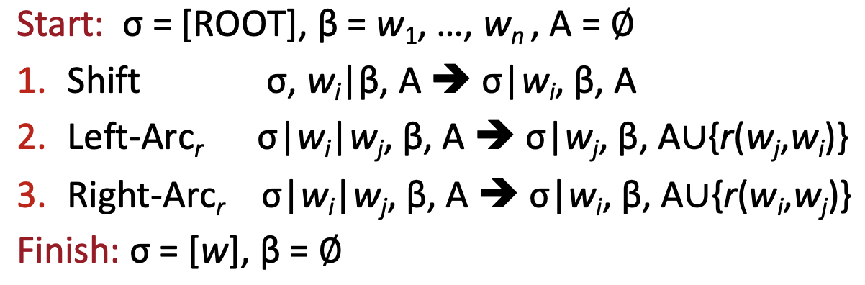
Greedy transition-based parsing
adding the
relationship

Slide 27
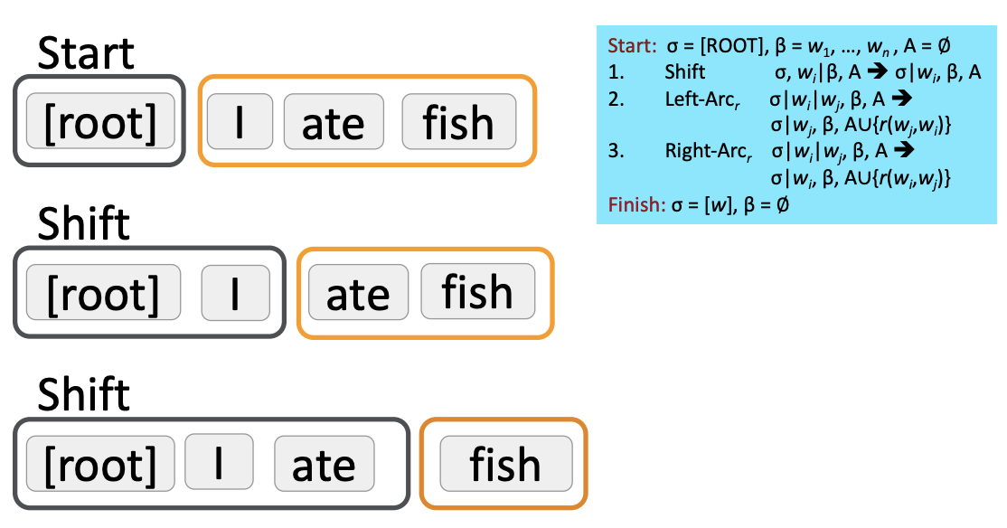
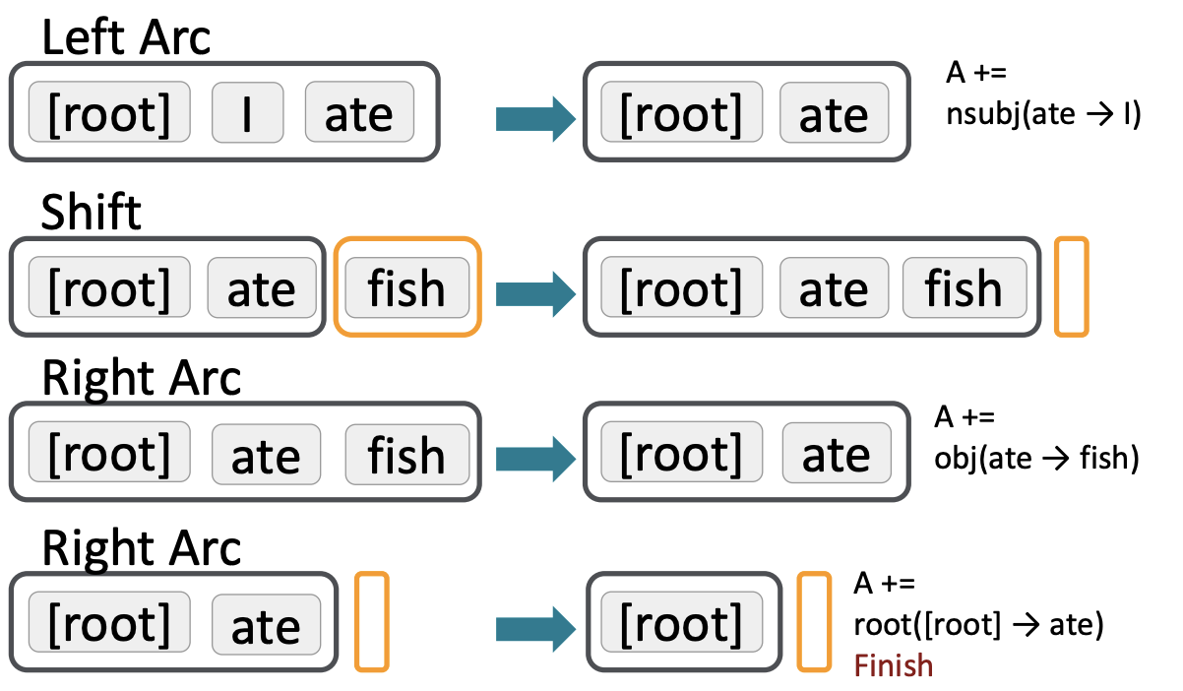
Greedy transition-based parsing
if the only thing in the stack is ROOT, we can only SHIFT
once we shift, we can either perform dependencies by doing LEFT-ARC or RIGHT-ARC. But here, let’s say my model tells me to SHIFT more
similarly, my model gonna decide whether to LEFT-ARC or RIGHT-ARC. It seems to be LEFT ARC, because “I” is the subject of “ate”
the dependent is gone. We add the dependencies to A
We SHIFT again. Nothing left on the buffer. We must do either RIGHT-ARC or LEFT-ARC. Let’s say the model tells me to perform RIGHT-ARC.
the dependent is gone. We add the dependencies to A
the dependent is gone. We add the dependencies to A. We stop when the buffer is empty and the stack contains only ROOT.

Slide 28
MaltParser [Nivre and Hall 2006]
So how to choose the right action??
Answer: Stand back, I know machine learning!
Each action is predicted by a discriminative classifier (e.g., SVM) over each legal move
Max of 3 untyped choices (shift, left, right); max of |R| × 2 (left, right) + 1 (shift) when typed (consider also the relations)
Features: top of stack word, POS; first in buffer word; etc.
For each word, the features are represented by a one-hot encoding vector. Since there could be millions of features, this vector tends to be very big….(10⁶)
There is NO search (in the simplest form)
But you can profitably do a beam search if you wish (slower but better)
You keep k good parse prefixes at each time step
The model’s accuracy is fractionally below the state of the art in dependency parsing, but it provides very fast linear time parsing, with high accuracy – great for parsing the web
MaltParser: A Data-Driven Parser-Generator for Dependency Parsing, Nivre et al., 2006. https://aclanthology.org/L06-1084/

Slide 29
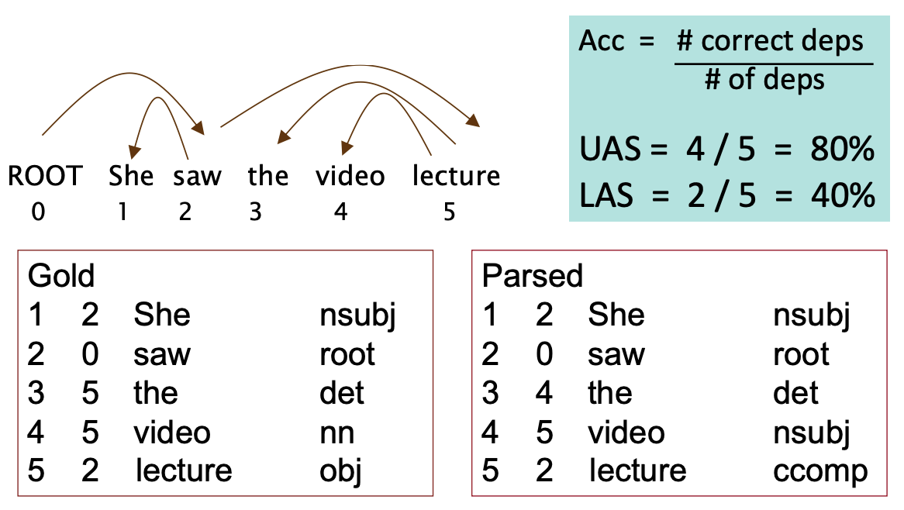
Evaluation of the parser
UAS (unlabeled accuracy score): Just count how many match without considering the relations (e.g., nsubj)
LAS (labeled accuracy score): the label (e.g., nsubj) must also match

Slide 30
Neural Dependency Parsing

Slide 31
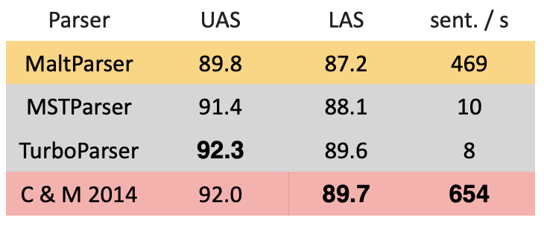
A neural transition-based dependency parser [Chen and manning 2014]
The traditional dependency parser feature vector is big and thus computationally costly
Instead use word embeddings!
Concatenated along with part of speech tags (POS) and dependency labels (represented as one-hot, but they are much smaller than the full vector anyway)
Still use the transition-based approach
Other research has further improved by adding deeper network, adding beam search, e.g., SyntaxNet and the Parsey McParseFace model (2016)
MST and TurboParser is graph-based with higher accuracy but is much slower….
A Fast and Accurate Dependency Parser using Neural Networks, Chen and Manning, 2014. https://aclanthology.org/D14-1082 / Announcing Syntaxnet: The World’s Most Accurate Parser Goes Open source https://ai.googleblog.com/2016/05/announcing-syntaxnet-worlds-most.html

Slide 32
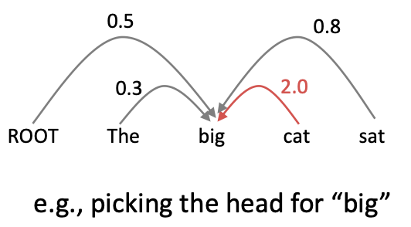
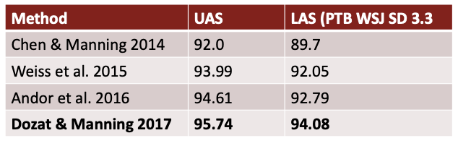
A neural graph-based dependency parser [Dozat and manning 2017]
Can handle non-projectivity, unlike transition-based
Compute a score for every possible dependency for each word
n² possible dependencies in a sentence of length n (this makes parsing slow)
Repeat the same process for each other word
Determine the optimal tree by using MST algorithm (in our Data Structure and Algorithms class)
Stanford’s Graph-based Neural Dependency Parser at the CoNLL 2017 Shared Task, Dozat et al., 2017. https://aclanthology.org/K17-3002.pdf

Slide 33
Summary
Dependency parsing is hard because of many possible ambiguities and paths
Dependency treebanks provide a useful ground truth we can based on
Two main approaches:
Transition-based: simple but does not work with non-projectivity
Graph-based: works with non-projectivity but very very slow…
Common way:
Use transition-based parser and then fix all non-projective paths manually
UAS and LAS are two common metrics for dependency parsing

